Slide 1
Automating goal-based adaptive mesh refinement for engineering problems
Joe Flood

Slide 2
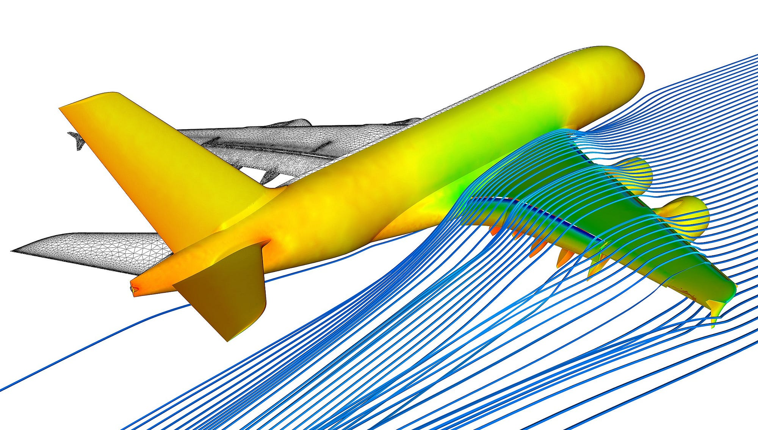
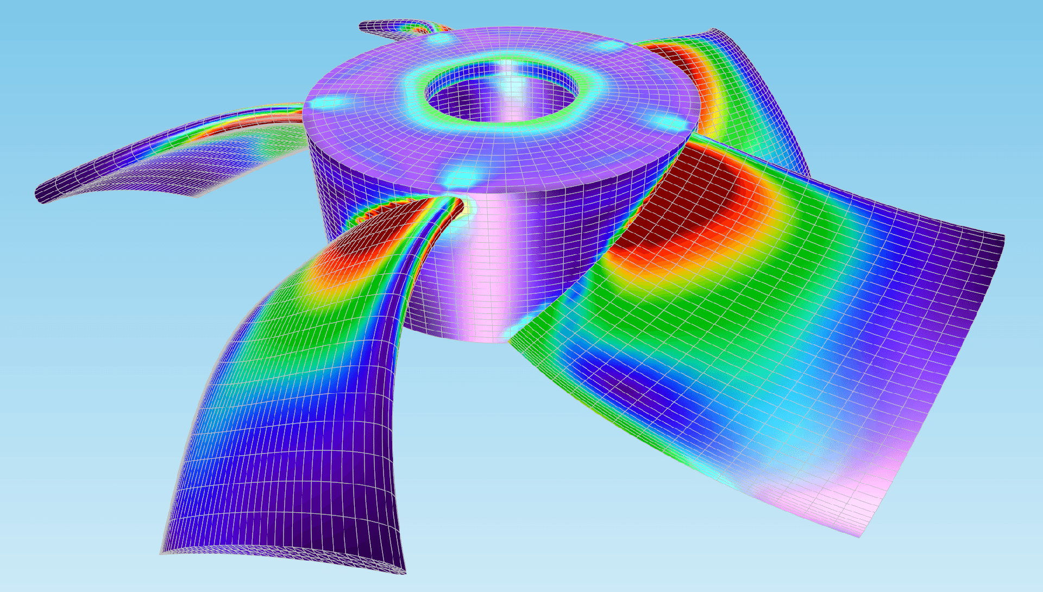
Engineers care about local outputs
Engineers don’t care about the entire solution field
Understanding the potential error is important
Lift, drag
Avg. stress on surface

Slide 3

Finite element methods
Differential operator:
$$Lu=f$$
Approximation:
$$Au_{h}=f_{h}$$
Accuracy depends on the mesh size ($h$)
Linear interpolation figure, showing different # points

Slide 4
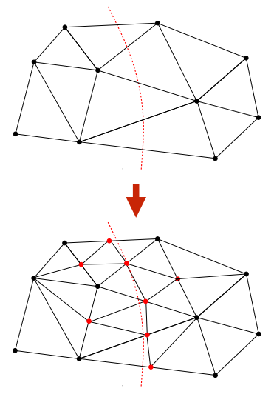

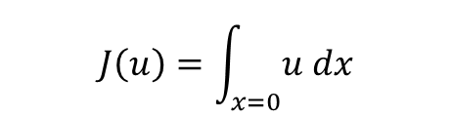
Solution: Goal-based adaptive meshing
$$J\left(u\right)=\int_{x=0}{u dx}$$
Define goal functional
Aim 1: Estimate error
Aim 2: Control error
How to control? Adapt mesh!
$$η≔\left|J\left(u\right)−J(u_{h})\right|≤ε$$

Slide 5
Current problems with implementation

Slide 6


How to estimate $η$?
$$r\left(v\right)=F\left(v\right)−a(u_{h},v)$$
Residual:
Define dual problem:
Derivation:
$$J\left(u\right)−J\left(u_{h}\right)=a^{∗}\left(z,u−u_{h}\right)=a\left(u−u_{h},z\right)=L\left(z\right)−a\left(u_{h},z\right)=r(z)$$
$$η=\left|r(z)\right|$$
$$a^{∗}\left(z,v\right)=J(v)$$

Slide 7
Automated error indicators

Slide 8
Automated algorithm

